Slide 1
CITY OF PHOENIX
REQUEST FOR QUALIFICATIONS
PRE-SUBMITTAL MEETING
WATER SERVICES DEPARTMENT
VAL VISTA WATER TREATMENT PLANT
RESERVOIR 3 (1-ES5-3) REHABILITATION
CONSTRUCTION MANAGER AT RISK SERVICES
WS85050019
PROCUREPHX PRODUCT CATEGORY CODES: 912000000
RFx Number: 6000001694
November 25, 2024

Slide 2
Welcome and
Introductions
City of Phoenix Representatives
Julie B. Smith, Contracts Specialist (Debra Russell Presenting)
Point of Contact for Submittal and RFQ Questions
Office of the City Engineer, Design and Construction Procurement
julie.b.smith@phoenix.gov (602) 534-2418
Aaron DiMaggio, P.E., Project Manager
Water Services Department
Notes:
MAKE STATEMENT: CHANGE OF CONTRACT SPECIALIST FROM LIZ BLAKLEY TO JULIE SMITH. INFORMATION WILL BE ALSO PROVIDED VIA A NOTIFICATION

Slide 3
Meeting Overview
Project Description
Scope of Work / Services
SOQ Evaluation Criteria / RFQ Overview
Submittal Requirements (Page Count)
Grounds for Disqualification
Important Dates: Selection Schedule
Procurement Webpages
ProcurePHX for RFX
Vendor Registration
Questions After Today
AGENDA
Questions are welcome after each presentation
Notes:
WHILE THE PM AND I WILL NOTE QUESTIONS ASKED, WE WOULD APPRECIATE ANY QUESTIONS ASKED HERE TODAY, PLEASE ALSO EMAIL TO JULIE SO WE HAVE THE EXACT UNDERSTANDING OF THE QUESTIONS.

Slide 4
Meeting Overview
PLEASE SIGN YOUR NAME, FIRM NAME, PHONE NO. AND EMAIL ADDRESS
IN ATTENDANCE SHEET
The Attendance Sheet, PowerPoint and Notification(s) will be posted on
City of Phoenix’s ProcurePHX system at:
https://eprocurement.phoenix.gov/irj/portal
(RFX 6000001694)
AND posted on City of Phoenix’s Procurement website:
https://solicitations.phoenix.gov
It is your responsibility as a RFQ holder to determine, prior to submittal,
if any Notifications have been issued.
This is your ONLY opportunity to discuss this solicitation with City staff.

Slide 5
Project manager
Aaron DiMaggio, P.E.
Water Services Department
Notes:
TURN OVER TO AARON HERE

Slide 6
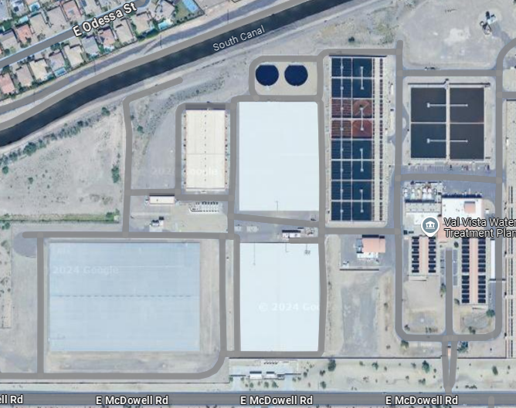
PROJECT DESCRIPTION
The City of Phoenix is seeking a qualified Construction Manager at Risk (CMAR) to provide preconstruction services and complete construction services for the Val Vista Water Treatment Plant Reservoir 3 (1-ES5-3) metal roof and liner replacement project.
The selected CMAR will work as a team with the designer of record and City staff to ensure an efficient design approach for the project. The reservoir is located near the intersection of 32nd Street and McDowell Road.
Notes:
AARON TO PRESENT NEXT SLIDES

Slide 7
Scope of work
The existing Reservoir 3 at Val Vista Water Treatment Plant is a 40 Million Gallon concrete potable water reservoir with hopper-style side slopes and metal roof. The protective interior liner and the roof have reached the end of their operational lifespan and need to be replaced. As a result, a complete rehabilitation of the reservoir is required.
The roof and liner replacement may include, but is not limited to the following:
New standing seam metal roof
New potable, NSF-61 certified membrane liner system 40MG Reservoir
New baffle walls
Required structural repairs including columns, roof framing and supports
Repair or replacement of internal and external gates, valves, and other mechanical equipment as recommended

Slide 8
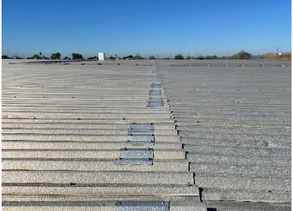
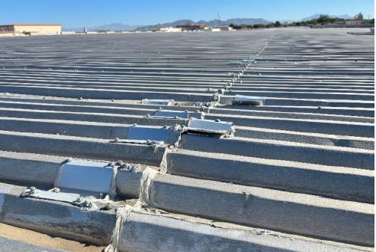
SCOPE OF WORK

Slide 9
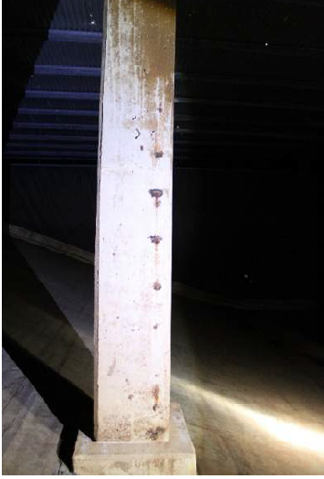
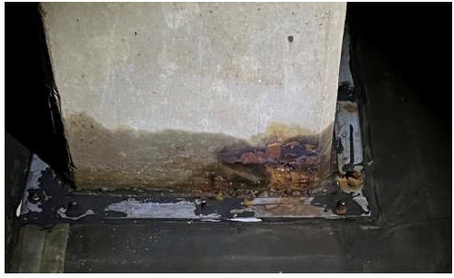
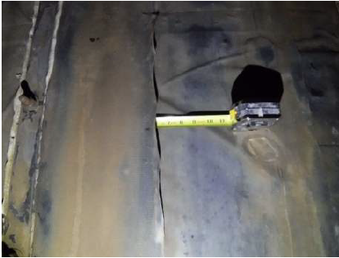
SCOPE OF WORK

Slide 10
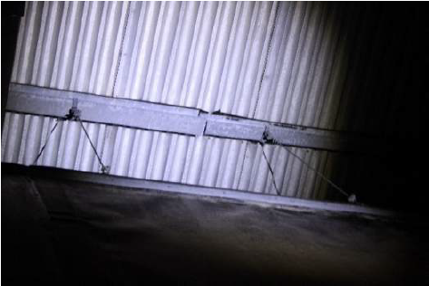
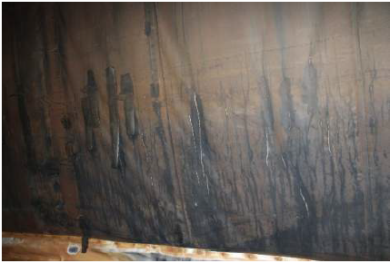
SCOPE OF WORK

Slide 11
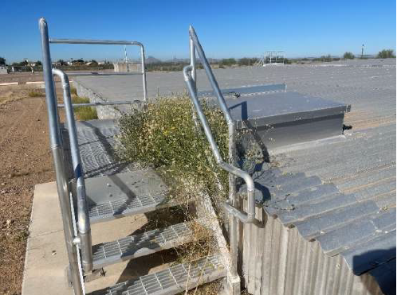
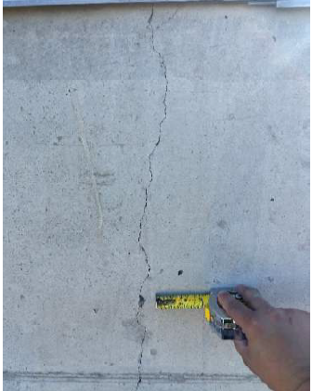
SCOPE OF WORK

Slide 12
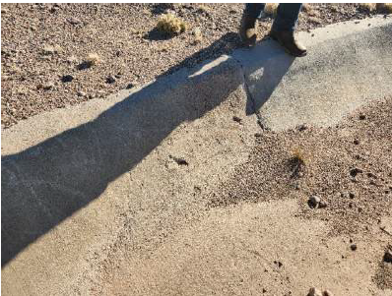
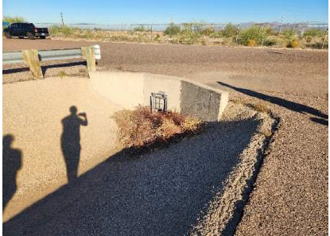
SCOPE OF WORK

Slide 13
QUESTIONS
Notes:
REMINDER: ANY QUESTIONS ASKED HERE TODAY, PLEASE ALSO EMAIL TO JULIE SO WE HAVE THE EXACT UNDERSTANDING OF THE QUESTIONS.

Slide 14
Soq evaluation criteria
Maximum Number of Points is 1000
General Information (150 pts max)
Experience and Qualifications of the Firm (250 pts max)
C. Experience of Key Personnel to be Assigned to this Project (250 pts max)
Understanding of Project and Approach to Perform Services (350 pts max)
Provide responses in the order listed in the RFQ
Be complete, be concise
*Reference Check (21 points)
*These points are in addition to the 1000 points for the SOQ
No formal interviews will be conducted
Notes:
GO INTO SOME DETAIL AND EXAMPLES AND EXPANDING ON CONTENT TO SUBMIT

Slide 15
SUBMITTAL REQUIREMENTS
Submit One (1) page Information Sheet:
Project title/number; RFx number; firm name (legal name), address, phone number, vendor number; project contact person name, title, email address and signature. Do not include any additional information.
Paper Size 8½” x 11”; Font size no less than 10 pt.
Each page containing resumes, evaluation criteria, and additional content will be counted toward the maximum page limit
Pages that have project photos, charts and/or graphs will be counted toward the maximum page limit noted above
CMAR SERVICES – BONDING STATEMENT: Separate PDF attachment. WILL NOT count towards maximum number of pages
MAXIMUM pages permitted is
12 pages:
The following will NOT be counted in the max page count:
Front and back covers
Information Sheet
Table of Contents
Grounds for disqualification:
Failure to submit via EMAIL to the assigned Contracts Specialist by the due date and time
Violating “Contact with City Employees” policy
Failure to submit Bonding Statement via email by the due date and time

Slide 16
Selection Process
Each SOQ will be evaluated according to the evaluation criteria in the RFQ.
A contract will be executed upon completion of negotiations of contract terms and City Council approval.
Notes:
No need to elaborate here

Slide 17
IMPORTANT DATES Selection Schedule
 SOQs DUE December 6, 2024
 SCOPE MEETING January 2025

Slide 18
DCP Procurement WEBPAGES
https://www.phoenix.gov/streets/procurement-opportunities
Current Opportunities:
Project-specific RFQs, Notifications, Sign-in Sheets, Presentations
https://solicitations.phoenix.gov
Project Interviews, Bid Results, and Project Selections:
https://solicitations.phoenix.gov/awards
The ProcurePHX online portal will be used for Solicitations only
https://eprocurement.phoenix.gov/irj/portal
Notes:
MENTION ABOUT SIGNING UP FOR BEING ON SELECTION PANEL – MUST BE senior level contractor rep required by ARS Title 34

Slide 19
DCP Procurement Webpages
https://www.phoenix.gov/streets/procurement-opportunities/
RFQ
Pre-Submittal Power Point Presentation & Sign-In Sheet
Preliminary Results
Final Results
Solicitations Website
Procurement Newsletter
Submitter’s Handbook

Slide 20
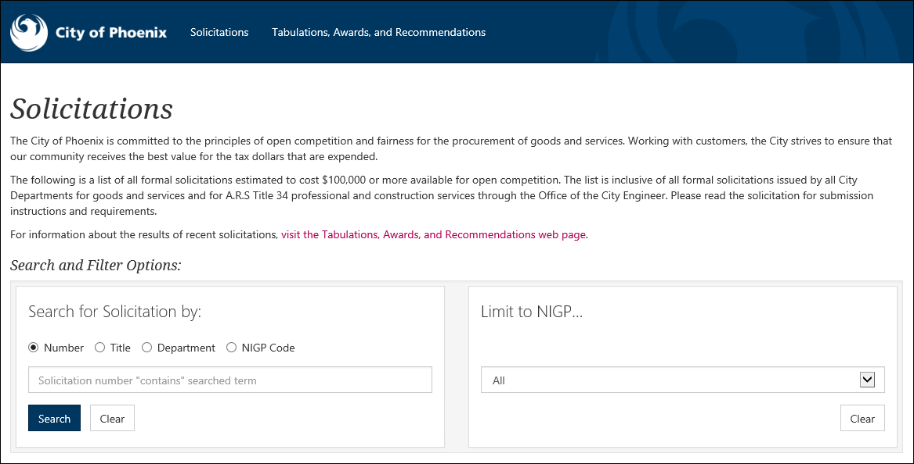
City of Phoenix Solicitations Website
1
2
Project-specific RFQs, Notifications, Sign-in Sheets, PowerPoint Presentations
Link to “Tabulations, Awards and Recommendations” web page
https://solicitations.phoenix.gov

Slide 21
Vendor Registration
All Firms MUST be registered in the Vendor Management System PRIOR TO SUBMITTING A SOQ
Information on how to register with the City is available at:
https://www.phoenix.gov/finance/vendorsreg
New Firms – After Registering, the City will send an e-mail with a vendor number in approx. 2 days
If your firm is already registered with the City of Phoenix’s ProcurePHX system, login and access the electronic solicitation at:
https://eprocurement.phoenix.gov/irj/portal
Product Category Codes are: 912000000
RFx Number is: 6000001694
The VENDOR NUMBER is to be included on the cover of the Statement Of Qualifications

Slide 22
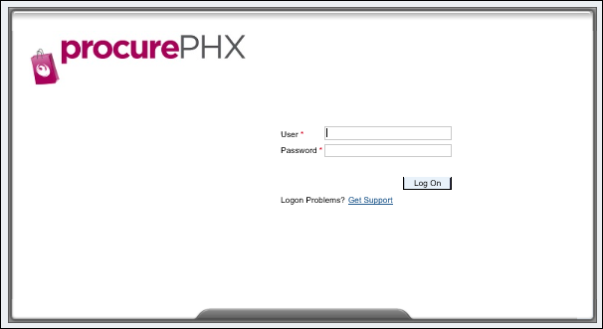
Login to ProcurePHX
If your firm is already registered with the City of Phoenix’s ProcurePHX system, visit https://eprocurement.phoenix.gov/irj/portal to login and access the electronic solicitation
Product Category Code is: 912000000
RFx (Event) Number is: 6000001694
Note: The VENDOR NUMBER is to be included on the cover of the Statement Of Qualifications

Slide 23
Email all questions to: julie.b.smith@phoenix.gov
Reference RFx Number: 6000001694
in your email subject line
Or call Julie B. Smith:
(602) 534-2418
Questions AFTER TODAY?
Stay for ProcurePHX Overview Thank You for Attending!!!

