Slide 1
Pre-Submittal Meeting
CITY OF PHOENIX
REQUEST FOR QUALIFICATIONS
WATER SERVICES DEPARTMENT
VAL VISTA TRANSMISSION MAIN REHABILITATION
ENGINEERING SERVICES
PROJECT NO. WS85500439 - RFx 6000001510
AND
VAL VISTA TRANSMISSION MAIN REHABILITATION
CONSTRUCTION MANAGER AT RISK
PROJECT NO. WS85500439 - RFx 6000001509
November 28, 2023

Slide 2
Welcome and Introductions
Julie B. Smith, Contracts Specialist II
Point of Contact for Submittals and RFQ Questions
Office of the City Engineer
julie.b.smith@Phoenix.gov (602) 534-2418
Dan Burt, Civil Engineer III – Project Manager
Water Services Department
Karina Matthiessen, Contract Compliance Program Assistant
Point of Contact for SBE Requirements
Equal Opportunity Department
karina.matthiessen@phoenix.gov (602) 261-8873

Slide 3
Meeting Overview
Sign-in please
Sign-in sheet and PowerPoint will be posted on Procurement’s website:
Solicitations - Solicitations City of Phoenix
It is your responsibility as an RFQ holder to determine, prior to submittal, if any Notifications have been issued
Please hold questions until Q&A period
This is the ONLY opportunity to discuss this project with City staff

Slide 4
Vendor Registration
All Firms SHOULD Be Registered in the Vendor Management System PRIOR TO SUBMITTING A PROPOSAL
New Firms – After Registering, the City will send an e-mail with a vendor number approx. 2 days
The VENDOR NUMBER is to be included on the cover of the Statement of Qualifications. Information on how to register with the City is available at:
https://www.phoenix.gov/finance/vendorsreg

Slide 5
Agenda
SBE Information
Project Description
Scope of Work
Engineering Services
Construction Manager at Risk Services (CMAR)
Statement of Qualifications Evaluation Criteria and Submittal Requirements
Engineering Services
Construction Manager at Risk Services (CMAR)
Selection Schedule
Engineering Services
Construction Manager at Risk Services (CMAR)

Slide 6
SBE GOAL
WILL BE ESTABLISHED
PRIOR
TO CONSTRUCTION

Slide 7
For More Information
On SBE Goal
Please Contact
Karina Matthiessen
602-261-8873
karina.matthiesen@phoenix.gov

Slide 8
Small Business Enterprise Program (SBE)
Goal Setting Methodology
Goals are established by City of Phoenix Goal Setting Committee
Successful Prime will work with the Small Business Engagement Team prior to goal setting
No established SBE goal for Design Phase
SBE goal for construction phase will be established upon substantial completion of design

Slide 9
Small Business Enterprise Program (SBE)
Pre-Award Requirements:
No SBE documents due at time of submittal
Outreach Efforts and SBE Plan should be actively in development

Slide 10
Small Business Enterprise Program (SBE)
Post-Award Requirements:
To locate certified firms:
https://phoenix.diversitycompliance.com
Select: Directory of SBE Certified Firms
REMEMBER:
Confirm certification status of a firm
Confirm certified scope of work
Statement of Proposed SBE Participation must be reviewed and approved by EOD prior to executions of each GMP

Slide 11
Project Description
Val Vista Transmission Main Rehabilitation (CMAR Delivery Method)
14.4-mile water transmission main from Lindsey and McDowell Roads to 48th St north of University Drive
The project consists of 12,400 linear feet of steel slip-lining pipe rehabilitation along various locations of the Val Vista Transmission Main with an inside diameter of 96-inches
Professional Services (Design and CA&I) and CMAR (pre-construction and Construction)
Estimated Construction Dates: Nov-Dec 2025, Nov-Dec 2026, and Nov-Dec 2027

Slide 12
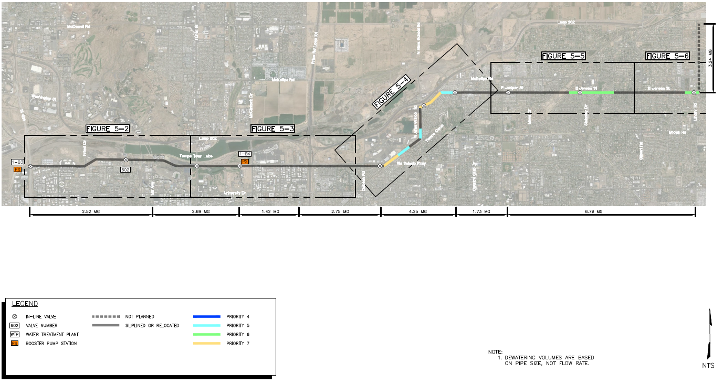
Project Site

Slide 13
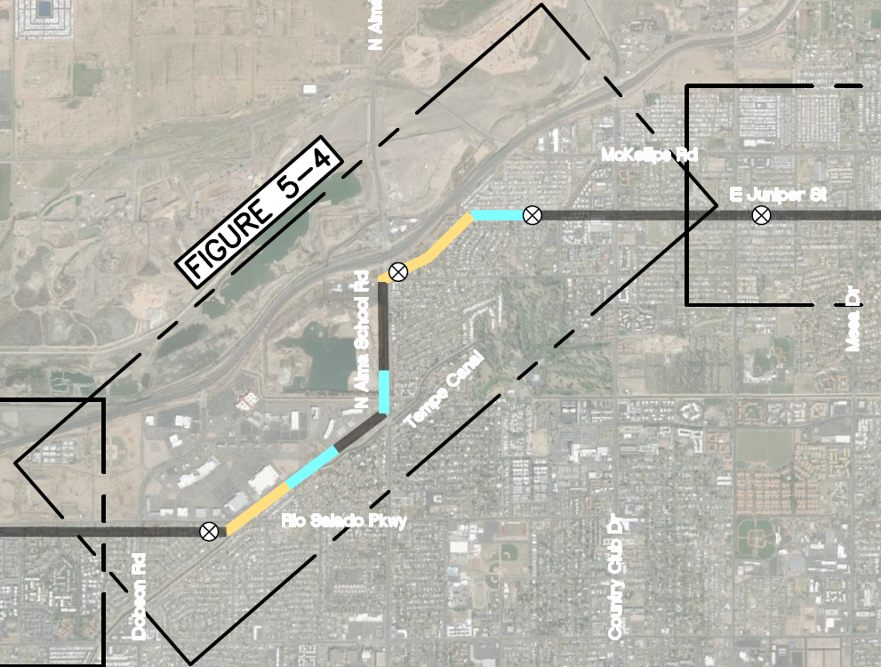
Project Site

Slide 14
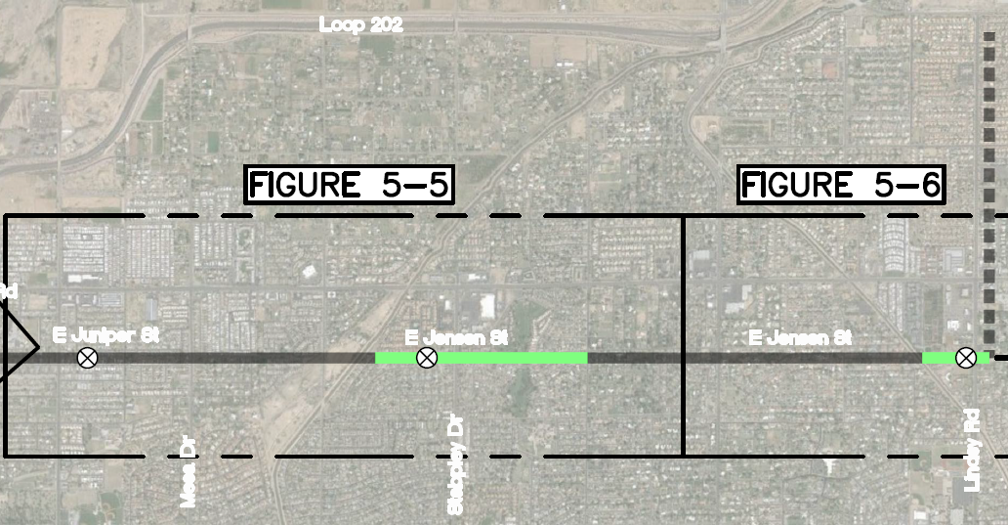
Project Site

Slide 15
Scope of Work
Engineering Services
Design Services
Provide rehabilitation recommendations and complete rehabilitation design for the priority 5 to 7 locations identified.
Provide construction documents and specifications for the rehabilitation design
Provide a construction schedule and engineer’s estimate of cost to construct and complete the main rehabilitation
Develop preliminary Maintenance of Plant Operations (MOPO) plans for pipeline shutdown and recharge
Coordinate with the Street Transportation and other City Departments as required on right-of-way and/or City owned property
Identify all utility locations both vertically and horizontally in conflict with proposed access pits. Coordinate with the City’s potholing contractor as necessary to establish utility locations.
Coordinate with other design consultants on adjacent projects, as needed
Conduct geotechnical evaluations to develop construction requirements
Investigate and identify traffic control impacts and costs using the City’s Right-of-Way Management Program
Obtain all applicable permits
All City standards shall be used to develop construction documents including but not limited to drafting standards and MAG standard specifications.

Slide 16
Scope of Work
Engineering Services
CA&I Services
General project administration, construction inspections
Resident engineering services during construction
Daily interaction with contractors to clarify job requirements
Administration of contractor’s contract
Decision-making regarding technical project issues
Monitoring of job progress
Review and certification of progress payments and job orders
Preparation of record drawings
Public information and public relations services, and coordination with other City Departments, governmental agencies and operations staff

Slide 17
Scope of Work
Construction Manager at Risk Services
Preconstruction Phase Services by the CMAR
Provide detailed cost estimating and knowledge of marketplace conditions
Provide project planning and scheduling
Provide for construction phasing and scheduling that will minimize interruption to City operations
Provide alternate systems evaluation and constructability studies
Advise City on ways to gain efficiencies in project delivery
Provide long-lead procurement studies and initiate procurement of long-lead items
Assist in the permitting processes
Participate with the City in a process to set a goal for local and SBE participation and implement the local and SBE process
Protect the owner’s sensitivity to quality, safety, and environmental factors
Advise City on choosing green building materials.

Slide 18
Scope of Work
Construction Manager at Risk Services
Construction Phase Services by the CMAR
Construct the 12,400 linear feet of steel slip lining pipe rehabilitation
Select subcontractors/suppliers for this project
Prepare a Guaranteed Maximum Price (GMP) proposal that meets the approval of the City
Coordinate with various City of Phoenix departments, other agencies, utility companies, etc.
Arrange for procurement of materials and equipment
Schedule and manage site operations
Bid, award, and manage all construction related contracts while meeting City bid requirements including the local and SBE participation goal
Provide quality controls
Bond and insure the construction
Address all federal, state and local permitting requirements
Deal with owner issues
Maintain a safe work site for all project participants

Slide 19
QUESTIONS
ON
SCOPE?

Slide 20
Statement of Qualifications Criteria
Engineering Services
Design Experience of Prime Firm – 150 points
CA&I Experience of Prime Firm – 150 points
Design Experience of Key Personnel and Subconsultants – 125 points
CA&I Experience of Key Personnel and Subconsultants – 125 points
Project Understanding and Approach – 300 points

Slide 21
Statement of Qualifications Criteria
Construction Manager at Risk Services
General Information – 150 points
Experience and Qualifications of the Firm – 250 points
Experience of Key Personnel to be Assigned to Project – 250 points
Understanding of Project and Approach to Performing Required Services – 350 points

Slide 22
Submittal Requirements
Information Sheet – 1 page – Only included: company name (legal firm name – not a trade name), address and contact information (include email of contact person), vendor number, project title and project number.
CMAR SOQ’s need to submit
EMR Rating on SOQ’s – the awarded company will be asked to provide verification upon contract execution.
Separate Bonding Letter – does not count towards final page count.

Slide 23
MAXIMUM pages permitted is 10 pages:
+ Evaluation Criteria (including organizational chart)
+ Additional Content (resumes or other information)
+ Photos, charts / graphs or other evaluation content
10 MAXIMUM pages permitted – Front/Back Covers, Information Sheet, Table of Contents, tabs or dividers are not included in page count unless they include evaluation criteria or additional content that could be considered by selection panel.

Slide 24
Grounds for Disqualification
Receipt of submittal after specified cut-off date and time.
Uploading submittal to the wrong project.
Failure to provide bonding statement – if required.
Violating “Contact with City Employees” policy.

Slide 25
Selection Schedule
DESIGN CONSULTANT SERVICES
SOQ’s Due December 8, 2023
Firm Notified for Award January 2024
Scope Meeting January 2024
CONSTRUCTION MANAGER AT RISK
SOQ’s Due December 8, 2023
Contractor Notified for Award January 2024
Scope Meeting January 2024

Slide 26
Street Transportation Procurement Section WEBPAGE
Tabulations, Awards, and Recommendations - Solicitations City of Phoenix
Notifications (if any)
Award
Pre-submittal Power Point Presentation
Pre-submittal Sign-in sheet

Slide 27
Questions After Today
E-mail your questions to:
julie.b.smith@phoenix.gov
PROJECT TITLE:
VAL VISTA TRANSMISSION MAIN REHABILITATION
PROJECT NO. WS85500439
ENGINEERING SERVICES RFQ
AND
CONSTRUCTION MANAGER AT RISK RFQ
Thank You for Attending !!!
Julie B. Smith
Contract Specialist II
(602) 534-2418

