Slide 1
RFQu 25-0504 Electrical Safety Training
April 15, 2025 – 2:00 p.m.
Via WebEx
Finance Department
Notes:
Welcome to the City of Phoenix’s Pre-Offer Conference for RFQu 25-0504, a Request for Qualifications for Electrical Safety Training services. My name is Margie Vasquez. I represent the City of Phoenix’s Central Procurement Division in the Finance Department, and I will be the facilitator for this Conference.
Joining me today, we have a Human Resources Division representative(s) who is/are here to assist in answering questions you may have regarding today’s presentation. At this time, I would like to invite our department staff to introduce themselves. [PANEL MEMBER INTRODUCTIONS.]

Slide 2
Welcome!
Please turn off or silence cell phones during this pre-offer conference.
Please mute your microphones, unless you are speaking, to mitigate background noise and potential electronic feedback for the other participants.
We will be touching on each major section of the solicitation, please try and limit your questions to the section being discussed.
Please add your questions to the chat during this pre-offer conference.
Notes:
Read first paragraph of solicitation:
The City of Phoenix invites sealed offers for Electrical Safety Training services for the City’s Human Resources Department, on an as-needed basis. for a five-year contract commencing on or about June 15, 2025, in accordance with the specifications and provisions contained herein or the “Effective Date” which is upon award by City Council, conditioned upon signature and recording by the City Clerk’s department, as required by the Phoenix City Code, whichever is later.

Slide 3
Legal Notice
The purpose of the Pre-Offer Conference is to provide a casual atmosphere to discuss the City’s intent and to determine whether the City’s requirements are clearly stated.
Although an exchange of information may take place, the official position of the City is that which is delivered in the solicitation document and in the form of a written Solicitation Addendum. Therefore, nothing said here today should be construed as a change to the written requirements in the solicitation document.
Any changes will be in the form of a solicitation addendum. Vendors must acknowledge receipt of any/all addenda by signing and returning the document with their submittal, or the response may be considered non-responsive.
Please note that it is the responsibility of the Offeror to read the entire solicitation document. Offerors must contact the Procurement Officer if they have any questions – no other City employees per the Transparency Policy.
Notes:
Read the legal notice.

Slide 4
Key Dates
Pre-Offer Conference April 15, 2025
at 2:00 p.m.
Written Inquiries Due April 17, 2025 (Thurs)
at 2:00 p.m.
City Responses Due April 21, 2025 (Mon)
at 10:00 a.m
Offer Due Date April 25, 2025 (Fri)
at 2:00 p.m.
Notes:
Please note the upcoming key dates for this solicitation. Written inquiries are due later today, April 17th (Thursday), by 2:00 p.m. All offers are due by April 25, 2025, at 2:00 p.m.

Slide 5
Agenda
RFQu 25-0504 Electrical Safety Training
Solicitation Instructions Overview
Scope of Work Overview
Terms and Conditions Overview
Insurance and Indemnification Requirements
Review Submittal Requirements
Closing

Slide 6
Qualification Criteria
RFQu Section 2.15 Qualification Criteria (Page 8)
Offerors must meet the following criteria in order to be considered for further evaluation of your offer:
Offeror must have at least five (5) years in business providing Electrical Safety Training services.
Five (5) years’ experience providing the services as listed in the solicitation for private and public entities comparable in size to the City of Phoenix (for an organization with 14,000 + employees).
Instructors must have at least five (5) years of documented NFPA 70 E training experience.

Slide 7
Solicitation Instructions
City's Vendor Self-Registration and Notification (RFQu Section 2.1 – Pg 5)
All must register at: https://www.phoenix.gov/procure
All offers shall be firm and fixed for a period of 180 calendar days from the Offer Due Date (2.3 Pg 5).
Exceptions (2.5 Pg 6)
Offerors must read the entire solicitation and accept all terms and conditions. It is the City’s preference to not receive exceptions.
Addenda: (2.7 Pg. 5)
City will not be responsible for oral instructions made by employees or officers, any changes will be in the form of a solicitation addenda.
Business in Arizona: Businesses must be registered with the Arizona Corporation Commission (this is checked) (2.8 Pg 5)
Transparency Policy in Effect (2.19 Pg 10)
All Communication through Procurement Officer
Posting of Solicitation through Council Approval
Notes:
CITY’S VENDOR SELF-REGISTRATION AND NOTIFICATION: Vendors must be registered in the City’s procurePHX Self-Registration System at https://www.phoenix.gov/procure to receive an award. The City may, at its sole discretion, reject any offer from an Offeror who has not registered.
Exceptions: (PDF pg 6) Offerors must read the entire solicitation and accept all terms and conditions. It is the City’s preference to not receive exceptions.
Addenda: City will not be responsible for oral instructions made by employees or officers, any changes will be in the form of a solicitation addenda.
BUSINESS IN ARIZONA: The City will not enter contracts with Offerors (or any company(ies)) not granted authority to transact business, or not in good standing, in the state of Arizona by the Arizona Corporation Commission, unless the offeror asserts a statutory exception prior to entering a contract with the City. (this is checked)
Transparency Policy:
This policy is intended to create a level playing field for all Offerors, assure that contracts are awarded in public, and protect the integrity of the selection process.
Begins at solicitation opening and ends at City Council Approval of Award.
All communication directly regarding this solicitation shall be through the procurement officer.
Offerors that violate this policy shall be disqualified.

Slide 8
Solicitation Instructions
Solicitation Inquiries (email procurement officer only)
Submission of Offer (2.11 – Page 7)
Electronic Submittal to procurement@phoenix.gov
Late Offers (2.22 – Page 12)
Preparation of Offer (Section 9 Submittals Pg 44)
All Forms in Submittal Section Must be Submitted (with no modifications).
Return the completed Pricing Proposal form
Demonstrate compliance with 2.15 Qualification Criteria and 2.16 Content of Response, including Sections 3 and 4 of the solicitation.
Contract Award (2.24 Pg 12)
The City reserves the right to award a contract by individual line items, by group, all or none, or any other combination most advantageous to the City. The City reserves the right to multiple award.
Notes:
Inquiries should be directed to the procurement officer via email before the deadline. The City will not consider questions received after the deadline. Please DO NOT submit questions to the Procurement mailbox. That is intended ONLY for the submission of offers.
Submission of Offer
Please submit early if possible to avoid any technical issues.
When submitting electronically, be mindful of size limitations when sending via email. May need to be submitted in parts.
Late Offers will not be considered and may be disqualified.
Preparation of Offer – Section 9 Submittals
(PDF Page 44) Ensure that all documents in Submittal Instructions & Evaluation Requirements at a minimum are Submitted.
Please do not make any modifications to the Submittal Forms unless the form allows modifications.
Award of Contract – read slide

Slide 9
Scope of Work
3.1 INTRODUCTION
City Departments will use the Qualified Offeror’s List to seek electrical safety training on as needed basis for employees who work on or near electrical hazards across all departments as required by the National Fire Protection Association (NFPA) – 70E.
The City’s Human Resources Department, Safety Division, oversees worker’s compensation, workplace safety, fleet safety, and the City of Phoenix Drug and Alcohol program.
The Safety Division has an overall mission to ensure all City of Phoenix employees receive required training needed to be successful in completing their daily work duties, reduce workplace injuries and injuries for City of Phoenix employees.

Slide 10
Scope of Work
3.2 LOCATION(S)
All trainings shall be conducted at City of Phoenix location(s) by the contractor(s). The locations will be determined at the time the City request services.
3.3 INSTRUCTORS
Instructors must have at least five (5) years of documented NFPA 70E training experience.
The assigned trainer must arrive at least twenty (20) minutes prior to the scheduled class time to set-up and check equipment.
3.4.TRAINING MATERIALS
All necessary training materials shall be provided for each student attending the class.
Each student must be able to keep hard copies for future reference.

Slide 11
Scope of Work
3.5.SERVICE REQUIREMENTS
The Contractor must provide the following electrical safety training on an as needed basis:
An 8-hour training course covering current NFPA70E documentation, including field application for medium voltage and 600 volt and below installations and maintenance
A 4-hour training course covering current NFPA70E documentation, including field application for 600 volts and below installations and maintenance.
Each training session must be able to accommodate a minimum of 15 students and a maximum of 35 students.
The training sessions identified above must meet the following minimum requirements:
The 8-hour training session must provide 8 continuing education units to each student in attendance.
The 4-hour training session must provide 4 continuing education units to each student in attendance.
At a minimum, the training sessions will cover the following:
Electrically Safe Work Practices;
Personal Protective Equipment (PPE) Selection;
Arc Flash Boundaries, Limited and Restrictive Approach Boundaries;
Equipment Assessment;
Arc Flash Reduction Applications;
Any changes required by the current edition of NFPA 70E; and
Any other applicable topics as identified by the City in advance of the training.

Slide 12
Scope of Work
3.6.SPECIAL TRAINING REQUIREMENTS
The current version of the NFPA70E must be available for purchase at any time throughout the contract period.
Training sessions shall be available throughout the contract period, scheduled within 30 days of City request.
Training materials shall be provided for each student attending the class.
A written examination must be provided to each student in attendance.
A course completion certificate must be provided to each student who successfully completes the training.
3.7.CANCELLATION OF SERVICES BY THE CONTRACTOR
Services may be cancelled by the Contractor. The Contractor must notify the City's project manager or designee in writing, within a minimum of fifteen (15) calendar days, prior to the date of the event and/or service.
It is at the City’s sole discretion to allow the Contractor to reschedule the services or to obtain the services from a different contractor from the Qualified Vendors List.

Slide 13
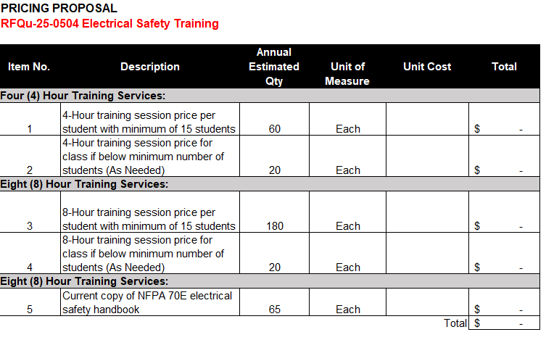
Pricing Proposal
Pricing Proposal Excel Attachment
The pricing proposal form provided by the City shall be used to submit your pricing NO EXCEPTIONS. Prices are all inclusive, additional fees and charges will not be allowed.

Slide 14
Special Terms & Conditions
Term of Contract (6.1 – Page 32)
Effective June 15, 2025 for a 5 year contract.
Price (6.2 – Page 32) - Pricing shall be firm and fixed for the initial one year. Price increases will be considered annually.
Background Screening (6.22 – Page 35)
Standard Risk Level Background Screening is the requirement of this solicitation and resulting contract.

Slide 15
Insurance & Indemnification
RFQu Section 7. Defense and Indemnification (Page 40)
RFQu Section 8. Insurance requirements (Page 41), the required coverages include:
General liability
Automobile liability
Worker’s compensation
Professional liability
*Please refer to this section for the coverage limits.
Upon award, certificates of insurance (ACORD form or equivalent) must be provided to the City within 10-days
A copy of your Certificate of Insurance is not required to be submitted with your offer.

Slide 16
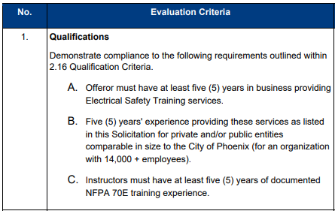
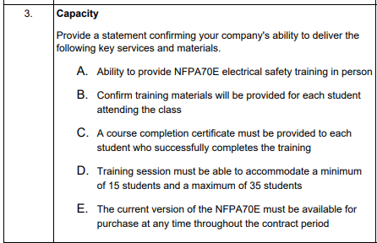
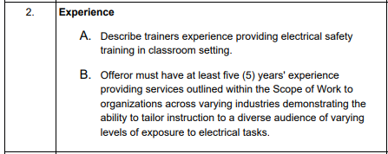
Evaluation Criteria
Page 17 - The offers will be evaluated based on the demonstrated compliance to the requirements listed in this section.

Slide 17
Submittals
Email the proposal to procurement@phoenix.gov
Do not email your Offer to the Procurement Officer
Submission of Offer (Pg. 7)
Submit your offer in accordance to this section.
Submittal Instructions (Pg. 44)
Offers must follow the submission requirements identified.
Reminders
Offer must be signed by a binding official
Signed Addenda must be returned with your offer
Completed Submittal forms must be returned with your offer
Notes:
Submittal Instructions & Evaluation Requirements – This section will aid you in preparing your offer with the minimum solicitation requirements. This list is not all inclusive, Offeror’s may provide any additional documentation as deemed appropriate by the Offeror which demonstrates compliance to the requirements.

Slide 18
Submittals
Complete and include the required submittal forms:
Costs and Payments
Conflict of Interest and Transparency
Offer Signature page
Years in Business and References
Return the completed Pricing Proposal
Please do not submit links or password protected documents
Late Offers will be rejected

Slide 19
Questions & Answers (Q & A)
Submit questions by April 17, 2025
2:00 p.m., local Phoenix time
Email to: Margie.Vasquez@phoenix.gov
Answers will be published via an addendum at the City’s solicitation website.
Solicitation Details - Solicitations City of Phoenix

Slide 20
Key Dates
Written Inquiries Due April 17, 2025
at 2:00 p.m.
Offer Due Date April 25, 2025
at 2:00 p.m.
Notes:
Please note the upcoming key dates for this solicitation. Written inquiries are due, April 17th (Thursday) by 2:00 p.m. All offers are due by April 25, 2025, at 2:00 p.m.
Thank you for the questions posed today and for participating in this pre-offer conference. For the questions posed today, we ask that you send them in writing to the procurement officer for written responses. Please remember the Transparency Policy is in effect and do not attempt to directly contact City staff or the subject matter experts in attendance today regarding this solicitation.
We look forward to receiving your offers for this important and impactful solicitation.

Slide 21
Questions

